Slide 1
Python! Day 15!
Continue the snake game

Slide 2
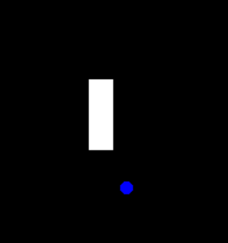
Creating the Snake’s Food
To create the snake’s food, let’s start by creating a new file called food.py and creating a food class after importing the turtle module
To create food, which will be little blue circles that disappear when the snake touches them, we will want our Food class to inherit from the Turtle class
This will allow the food to do anything a turtle can with some extra things
To do this, we can write:
from turtle import Turtle
class Food(Turtle):
def __init__(self):
super().__init__()

Slide 3
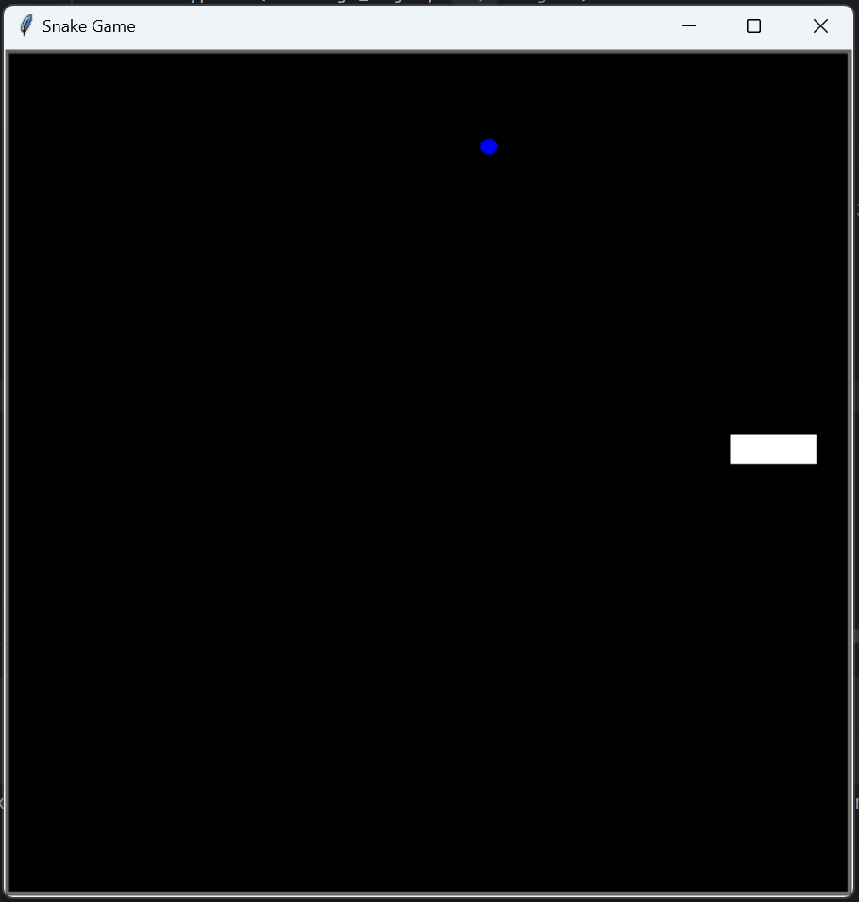
Next, we’ll want to, in our __init__ function, write everything needed to create the food object using turtle methods.
We’ll want to make the shape a circle, make the color blue, make the animation speed fastest, decrease the size by 50% (so the food isn’t too big), set the pen up, and send the food to a random location.
Finally, in our main.py file, after we create the snake object, let’s create a food object
from turtle import Turtle
import random
class Food(Turtle):
def __init__(self):
super().__init__()
self.shape("circle")
self.penup()
self.shapesize(stretch_wid=0.5, stretch_len=0.5)
self.color("blue")
self.speed("fastest")
x_pos = random.randint(-280, 280)
y_pos = random.randint(-280, 280)
self.goto(x_pos, y_pos)

Slide 4
Detecting Collisions with the Food
To detect collisions with the food in our main.py file, we can use the distance() function to find the distance between the snake head and the food
If the distance is less than 15 pixels, the snake and food are probably colliding, so we should move the food to a new random location
To start, let’s write a refresh() method in our food file that refreshes the food’s position
Then, in our main.py file, we can write:
if snake.segments[0].distance(food) < 15:
food.refresh()

Slide 5
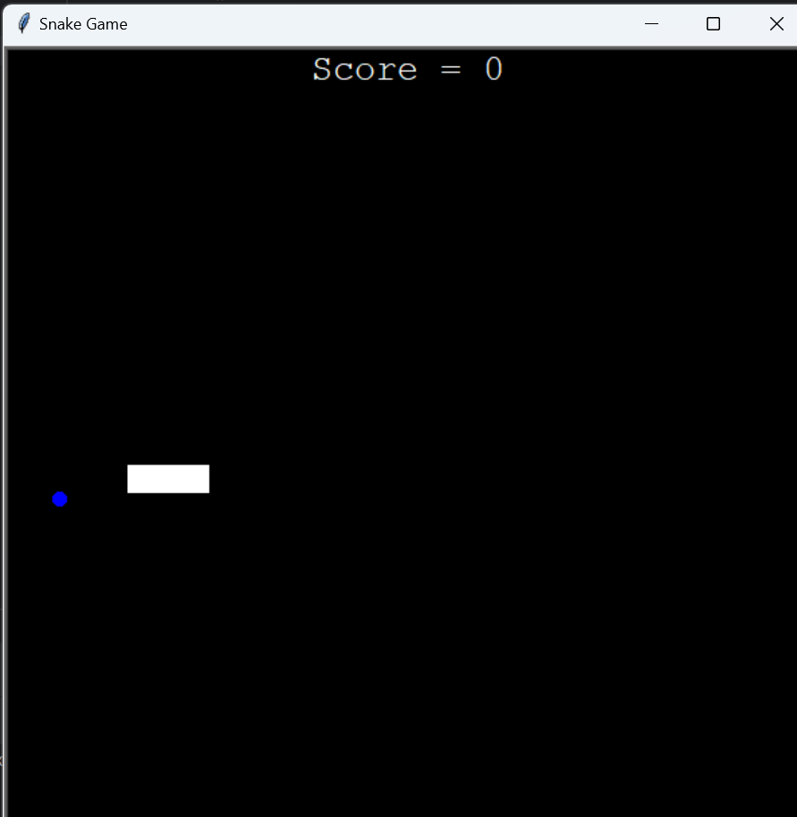
Create a Scoreboard
Like the food, we’re going to create a scoreboard class that inherits the turtle class
In the scoreboard class, we’ll use the turtle.write() method to write the player’s score
To start, let’s create our scoreboard class and in the __init__ method, we’ll make the scoreboard white, hide the turtle, put the pen up, set speed to fastest, set the color to white, and send the turtle to the top of the screen
We can also create a variable called “score” and set it equal to 0

Slide 6
from turtle import Turtle
class Scoreboard(Turtle):
score = 0
def __init__(self):
super().__init__()
self.hideturtle()
self.penup()
self.goto(0, 270)
self.color("white")

Slide 7
Writing with the Scoreboard
Next, we’ll want to write using the scoreboard. For this, we can use the turtle.write() method
Let’s write this inside a new method called update_text
Inside update_text(), let’s also clear all writing because otherwise, we’ll end up writing every new score on top of the previous ones
def update_text(self):
self.clear()
self.write("Score = " + str(self.score), align="center", font=("Courier", 20, "normal"))
Now, we can call self.update_text() at the end of out __init__ method

Slide 8
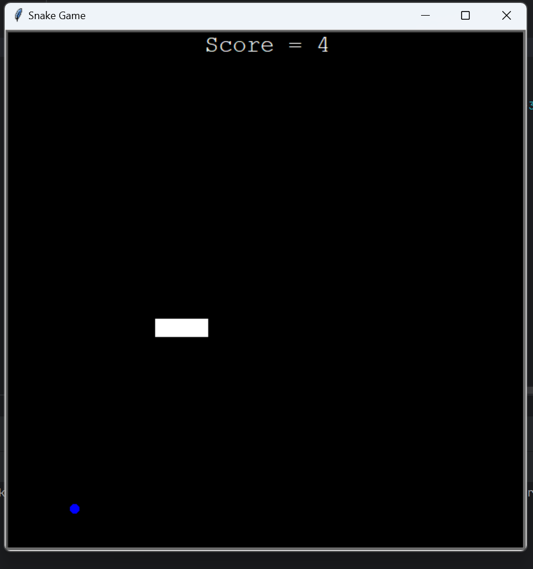
Increasing the Score
Next, let’s write a method that increases the score by 1 and calls update_screen():
def increase_score(self):
self.score += 1
self.update_text()
Then, we can return to our main.py file and create a scoreboard object where we create the snake and food
Finally, when the snake collides with the food, we can write:
scoreboard.increase_score()

Slide 9
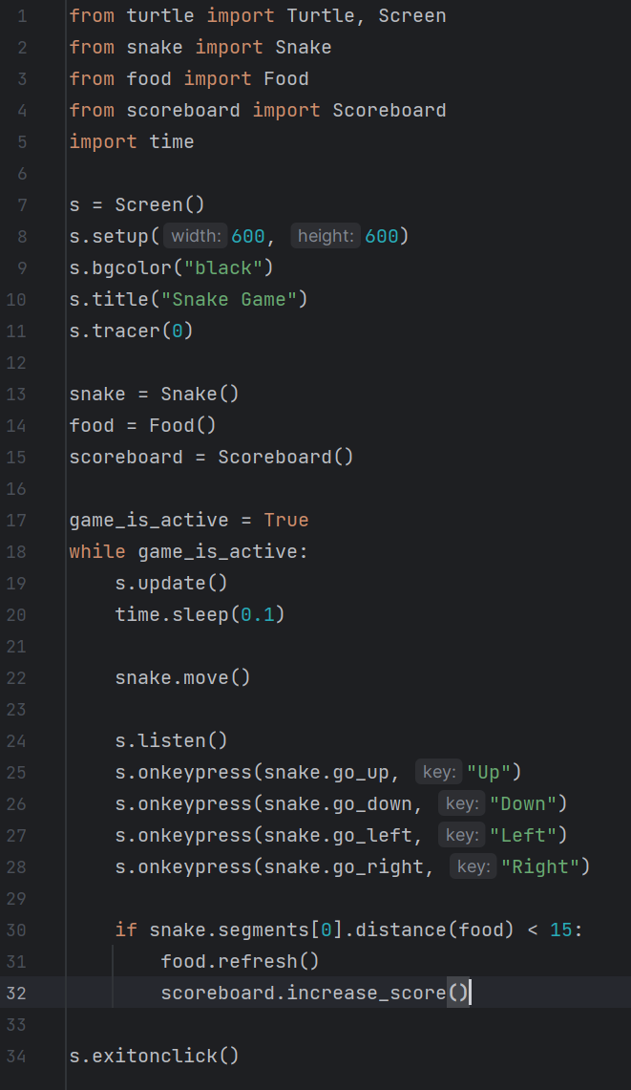

Slide 10
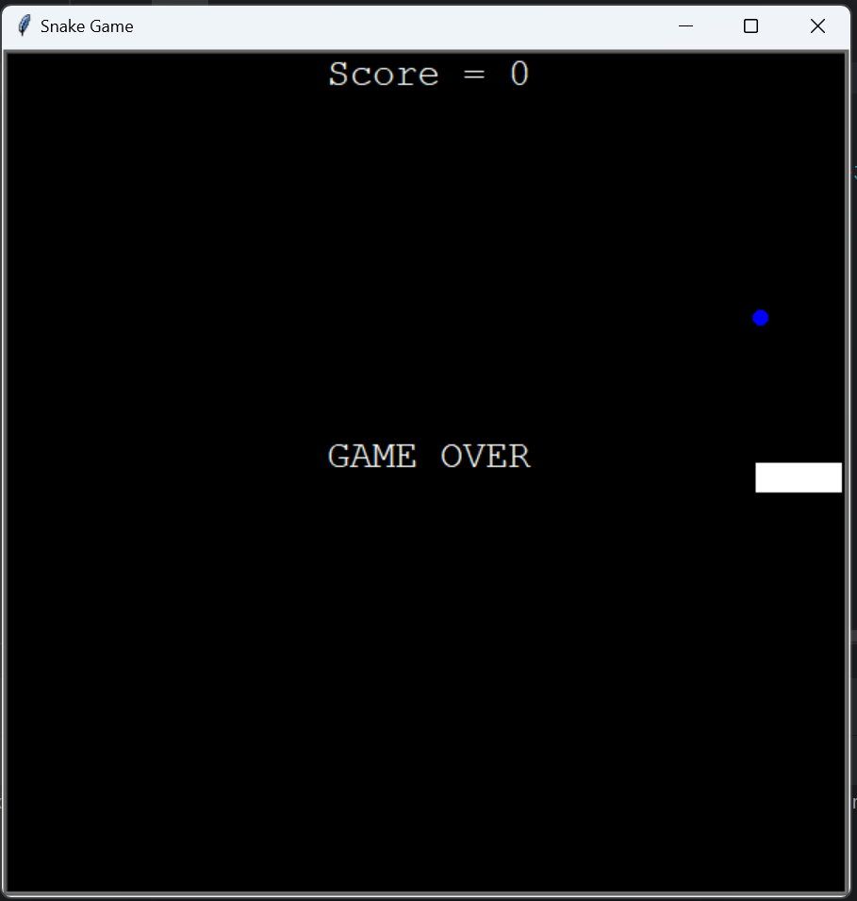
Writing “Game Over” with the Scoreboard
For the next step of the game, let’s write “GAME OVER” with the scoreboard in the middle of the screen when the player hits the wall
To do this, let’s start by writing a game_over method in our scoreboard class that looks something like this:
def game_over(self):
self.goto(0, 0)
self.write("GAME OVER", move=False, align="center", font=("Courier", 20, "normal"))

Slide 11
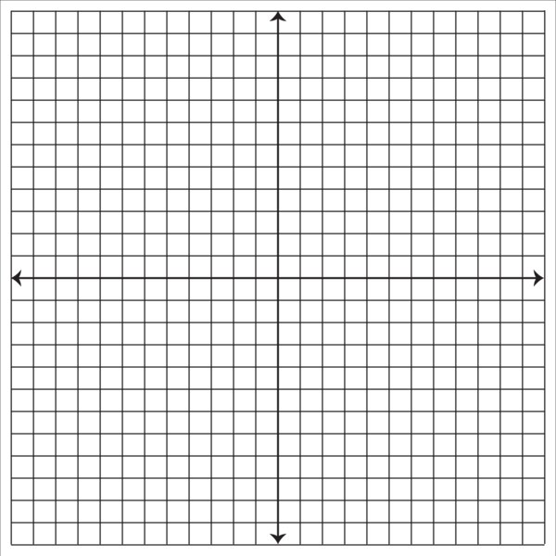
Detecting Collisions with the Wall
300
For this, we’ll just want to write an if statement that looks like this:
if snake.segments[0].xcor > 280 or snake.segments[0].xcor < -280 or snake.segments[0].ycor > 280 or snake.segments[0].ycor < -280:
scoreboard.game_over()
game_is_active = False
-300
300
-300

Slide 12
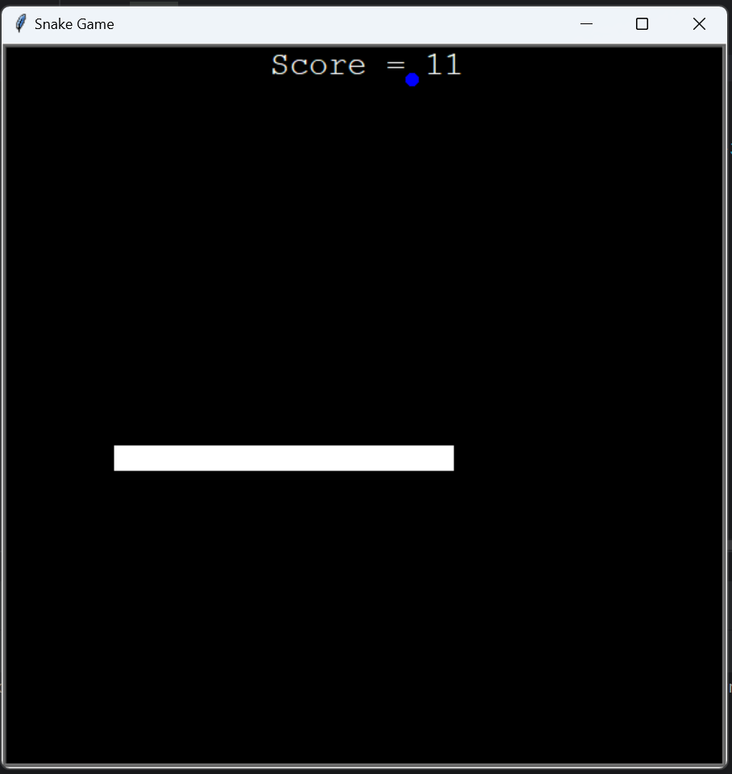
Making the Snake Longer
Whenever the snake eats food, we need to make the snake longer
To do this, let’s go to the snake.py file and add a method called extend()
In this function, we’ll copy some of the code from when we were creating the snake, except we’ll set the position of the new segment to the last segment of the snake
Like this:
segment.goto(self.segments[-1].position())
Then, we’ll want to call snake.extend() when the snake collides with the food

Slide 13
def extend(self):
segment = Turtle("square")
segment.color("white")
segment.penup()
segment.goto(self.segments[-1].position())
self.segments.append(segment)

Slide 14
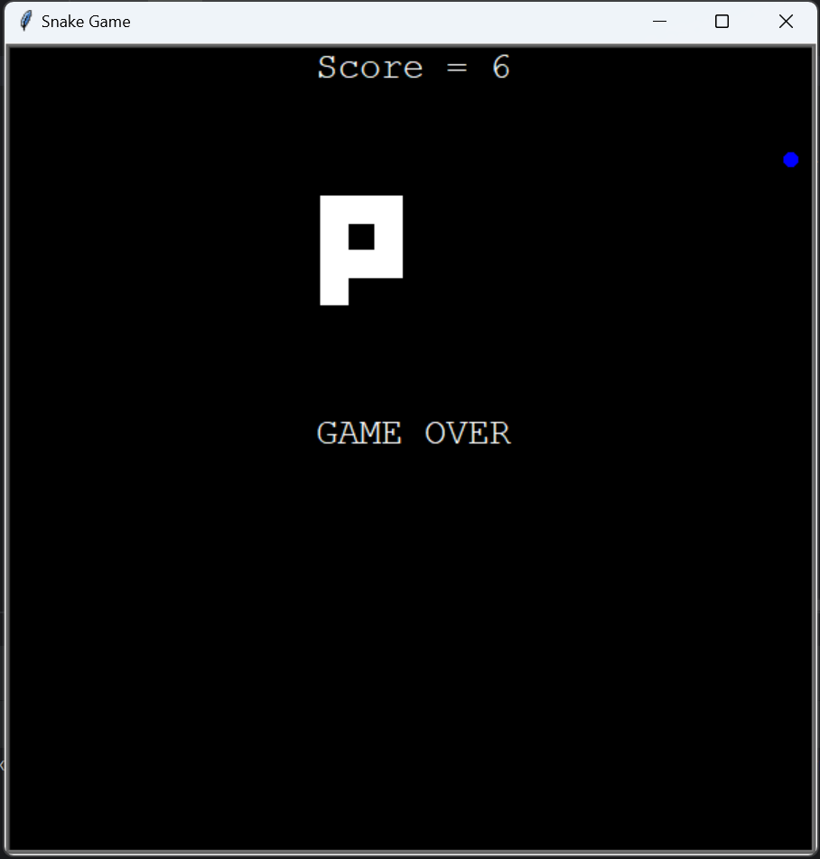
Detect Collisions with the Tail
Finally, we’ll want to detect if the head of the snake is colliding with the tail
We can do this by looping through all of the snake segments (except the head) and seeing if the distance, and each segment is less than 10
If it is, we’ll end the game:
for n in range(1, len(snake.segments)):
if snake.segments[0].distance(snake.segments[n]) < 10:
scoreboard.game_over()
game_is_active = False

Slide 15
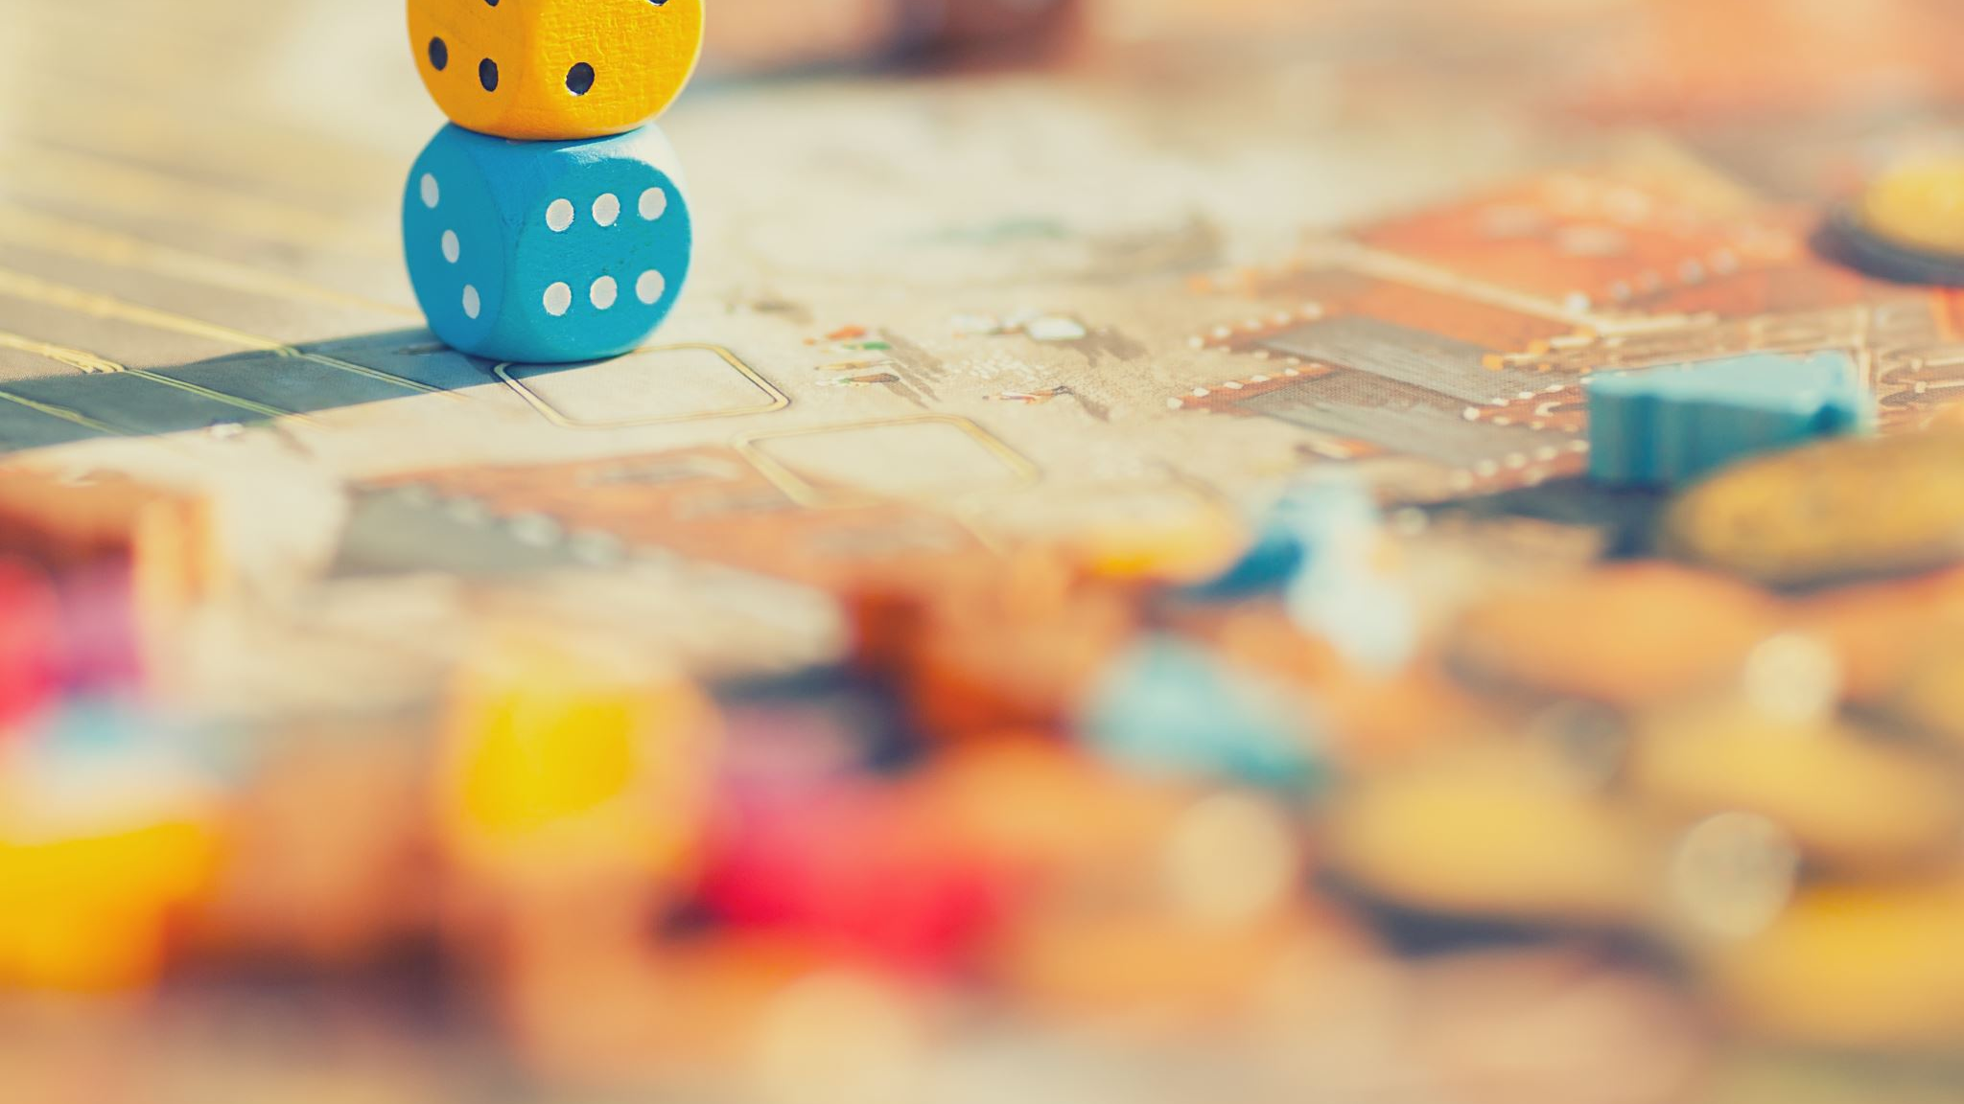
Finished with the Snake Game!!

